Slide 1
Automated Cloud Management through Experimental Measurements
Calton Pu
Professor and J.P. Imlay Chair in Software
CERCS, Georgia Institute of Technology
Many PhD, MS, Undergrad students
Collaborators from HP Labs (CA), ATT Labs (NJ), IBM Research (NY), Intercontinental Exchange (GA), Wipro (India), Fujitsu Labs (Japan), NEC Labs (CA), Intel ISTC-CC (PA), Xerox (NY), Univ. Freiburg (Germany), Univ. Tokyo (Japan), and other companies

Slide 2
“NewElba” Focus and Publications
Experimental studies analyzing performance data from production-scale experiments on “real data centers”
More than 50 papers (2005 – 2017)
In 2016: 5 papers
IEEE CLOUD, SCC, ICDCS, IRI, BigData Congress, BigData, ACM TRIOS
5 papers on millibottlenecks, formerly referred to as transient bottlenecks. More to follow!.

Slide 3
Importance of N-Tier Systems
Scalable distributed architecture
Division of labor for low-latency tasks
Web servers for parsing/HTML handling
App servers for business logic handling
DB servers for consistent data management
Separation of stateless from stateful
DB servers handle the difficult state part
Web and App servers are “stateless” so more instances can be easily added, if needed

Slide 4
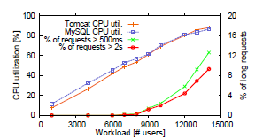
Latency Long Tail Problem
At moderate CPU utilization levels (about 60% at 9000 users), 4% of requests take several seconds, instead of milliseconds

Slide 5
Latency Long Tail: A Serious Research Challenge
No system resource is near saturation
Very Long Response Time (VLRT) requests start to appear at moderate utilization levels (often at 50% or lower)
VLRT requests themselves are not bugs:
They only take milliseconds when run by themselves
Each run presents different VLRT requests
VLRT requests appear and disappear too quickly for most monitoring tools

Slide 6
Tooling Requirements for Diagnosing Latency Long Tail
Event monitoring
Resource monitoring
Sophisticated analytics
Dependency graphs
Orthogonal needs:
Enormous data variety challenge demands clever parsing techniques
Bottom-up and top-down analytical procedures to manage uncertainty with respect to “true” root cause

Slide 7
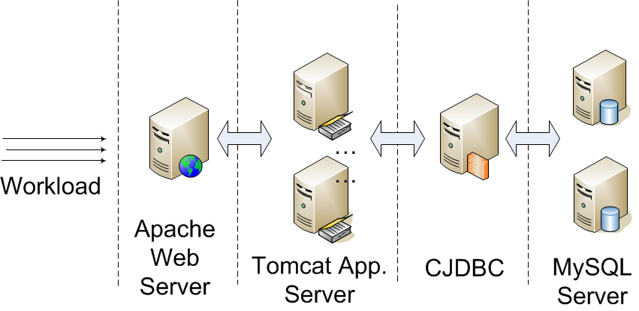
Web-Facing Multi-Tier Apps
Example: RUBBoS benchmark based on Slashdot
Sample configuration (1/2/1/2)
Notes:
This slide shows VM configuration

Slide 8
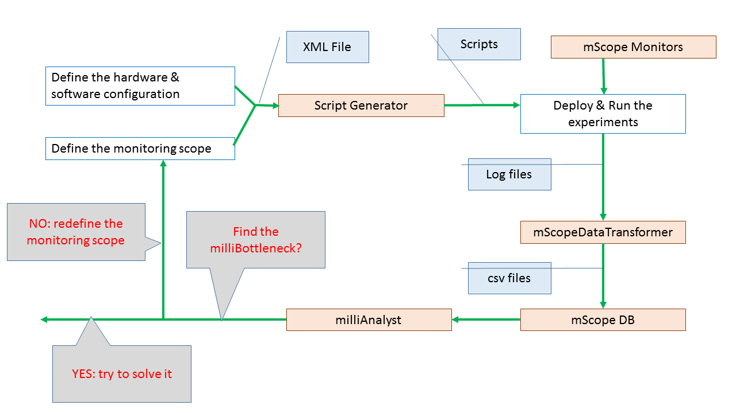
milliMonitor – alpha (v0.1)

Slide 9
milliMonitor Overview
Each component aligns with one of the phases of our pipeline
Generate Experiment – specifying an experiment and generating artifacts
Execute Experiment – automatically provisioning a cloud and deploying the artifacts
Analyze Experimental Data – automatically collecting, parsing and reasoning over the data

Slide 10
milliMonitor High Level Design
Templates & Script Generator
Aspect-oriented code generator
Specializes scripts, benchmark source code and configuration using XML-based spec.
mScope Monitors
Inject measurement schema into benchmark
Record identifier, timestamps and output in native benchmark logs
mScope Data Transformer, mScope DB
Ingest and normalize data from mScope monitors
Dynamic database to persist transformed data
milliAnalyst
Combines known millibottleneck mechanisms with data
Reduces millibottleneck identification and root cause isolation / determination into a longest path problem

Slide 11
Assumptions & Base Requirements
Our infrastructure generally assumes:
Logical hostnames - network name resolution is handled by clouds’ resource scheduling and management facilities
Physical hosts
Supported clouds: Emulab, PRObE (cmu)
Must use FC15RUBBOS image on nodes
Image available in cloud repo. and Elba repo.
Automated analysis only supports topologies with one database node
Do not manually modify any generated artifacts; always regenerate the experiment!
Notes:
Note: we can provide scripts on a request basis, which support physical networking and virtualized hosts; however, these will require manual modification

Slide 12
Generate Experiment
Describe automated cloud experiment generation pipeline
Steps to create experiment, artifacts:
Pre-condition: account and project access on cloud environment
Edit network configuration file (NSFile)
Log into cloud environment and create experiment using provided web interface
emulab.net
marmot.pdl.cmu.edu
Edit the default Experiment XML
Execute runRubbosExperiment.sh

Slide 13
Experiment Specification
XML file which describes the “tuning knobs” for the experiment
Modify at a minimum the following parameters:
EXPERIMENT_NAME
OUTPUT_HOME
Workloads
Align “instances” to topology defined in NSFile
Used in conjunction with runRubbosExperiment.sh
Full data dictionary available in the document entitled, “Detailed Instructions,” on the Elba Github repo.

Slide 14
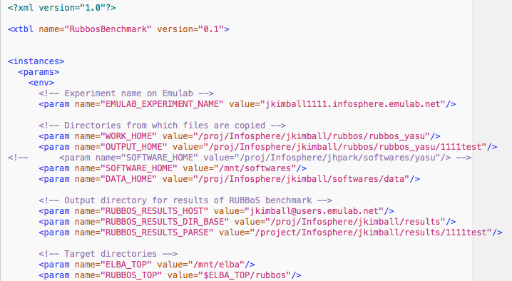
Example Experiment XML

Slide 15
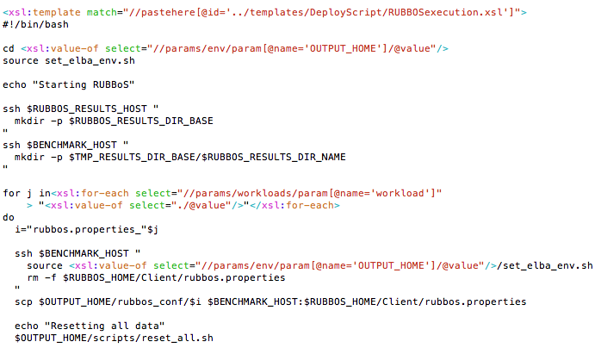
Example Template

Slide 16
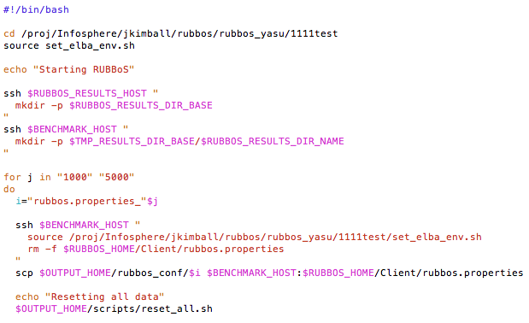
Example Generated Script

Slide 17
Execute Experiment
Explain our monitors
Why they are needed
What they do and the data they provide
Steps to successfully execute an experiment
Swap the experiment using the appropriate cloud environment’s web interface
ssh to the shared filesystem for the cloud environment
users.emulab.net
marmot-ops.pdl.cmu.edu
After the experiment successfully swaps, “ssh” to the controller node, “node1”
node1.experiment_name.project_name.emulab.net
node1-eth1.experiment_name.project_name.emulab.net
Navigate to generated experiment’s directory and in the “scripts” folder, execute the “./run.sh” script

Slide 18
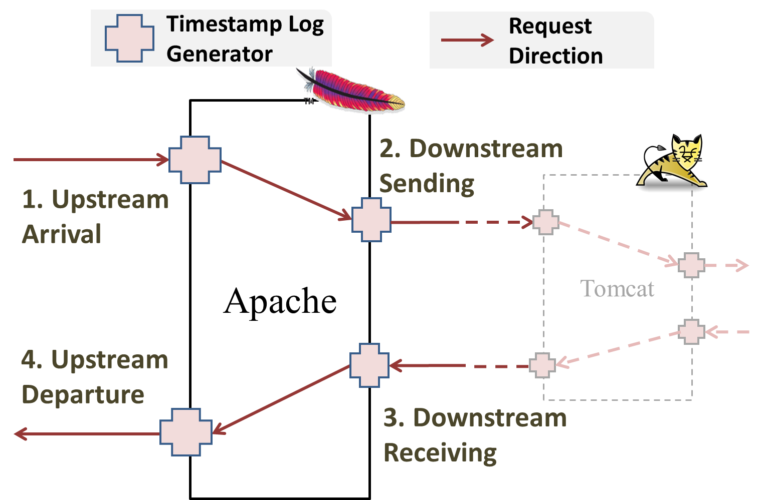
event mScopeMonitors
Currently, we have implemented Apache, Tomcat, CJDBC, and Nginx event mScopeMonitors
Each event mScopeMonitor records four timestamps for each request on each component, which can be used to rebuild the causal relationship.

Slide 19
Apache Example
Insert the requests ID as an URL parameter
http://rubbos/StoriesOfTheDay?ID=XXX
Extend the response data structure by adding variables for storing the Downstream Sending and Downstream Receiving timestamps:
apr_time_t ds_time, dr_time;
Add calls to Apache Portable Runtime (APR) library to record the timestamps:
r->ds_time = apr_time_now();
// sending the request to Tomcat ……
// receiving the request from Tomcat
r->dr_time = apr_time_now();
Write the timestamps into the existing log files:
apr_psprintf(“% %”, APR_TIME_T_FMT, r->ds_time, r->dr_time);
Sample Output

Slide 20
resource mScopeMonitors
Collectl: A monitor tool capable of recording system resource utilization, including CPU, memory, process runtime state, network and disk I/O at fine granularity (every 50ms).
SAR: collects, reports and saves system activity information (CPU, memory, disks, interrupts, network interfaces, TTY, kernel tables,etc.)
IOStat: reports CPU statistics and input/output statistics for devices, partitions and network filesystems.

Slide 21
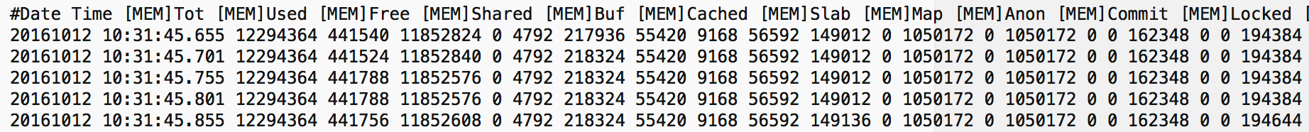
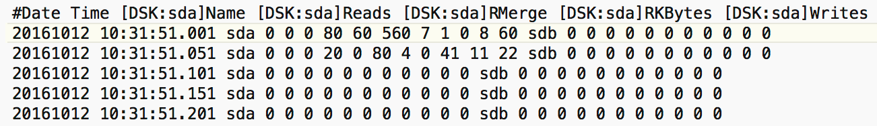
Collectl Example
Initialization string
Sample output (CPU, Mem/Net, Disk)

Slide 22
Analyze Experiment
Explain our approach to data transformation, integration and management
Detail how we use the gathered data to isolate millibottlenecks and diagnose their root cause
Describe the steps needed to analyze the experiment
Copy the tarball archive containing the experiment data to a location proximate to the cloned Elba Github repo.
Unzip this archive
Navigate to the parsers directory of the cloned Elba Github repo.
Execute “runparsers.sh” by providing
path to the directory containing unzipped archive
target location to store the processing results

Slide 23
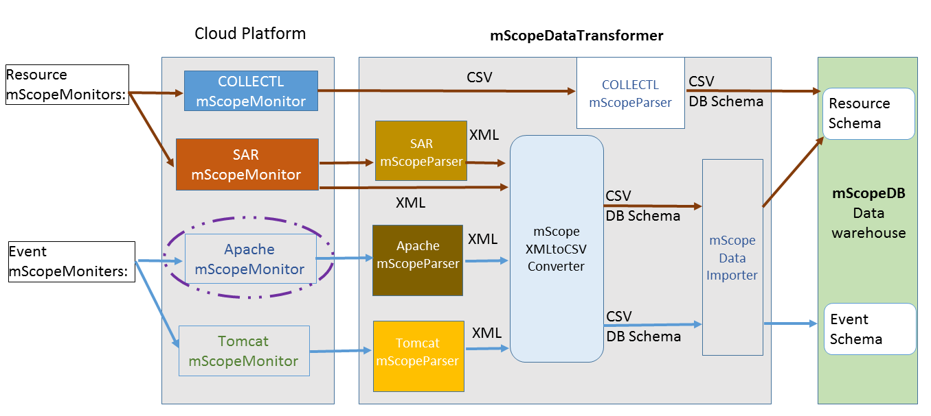
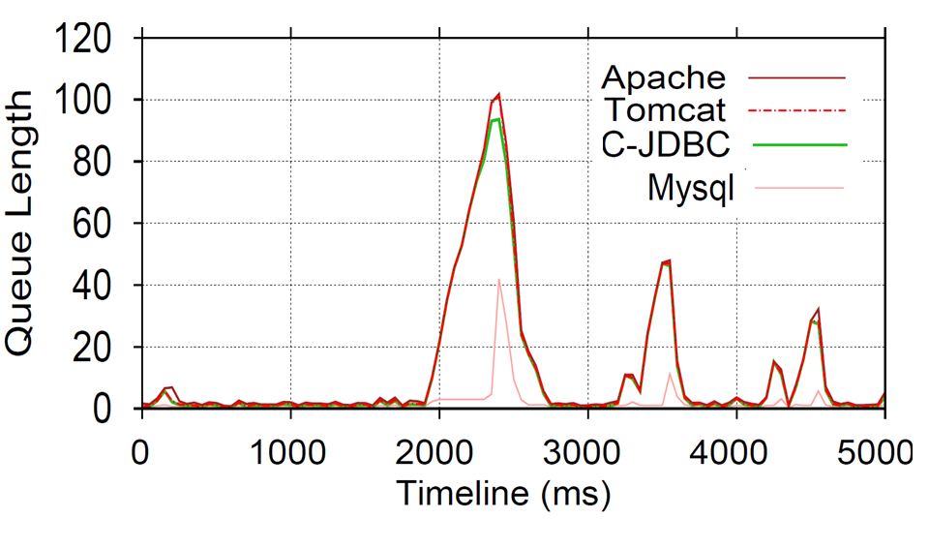
milliScope Dataflow & Architecture
mScopeDataTranformer transforms the native logs into structured tuples for loading into mScopeDB for advanced analysis, such as queue length.

Slide 24
Other parsers
Cparsers – extract request-level data out of component logs. These are pictured in addition to Resource parsers
ServiceTime – reads request-level data and calculates dst
Pointintime – reads request-level data (Apache) and calculated pit
Multifile – basically joins and aggregates data in uniform entities (dst_table, resource_table); pit is independent
How to reconcile not ingesting XML into mScopeDataTransformer?
Component parsers were supposed to output XML
Even if they were, we still need to calculate aggregates like queue lengths and dst
Prob in database; the issue with this is trying to do the integration and calculation when the schemas change…
Or, compute aggregates externally and import

Slide 25
mScopeDataTransformer Design
Data pipeline transforms highly variable monitoring data into aggregates that are helpful in millibottleneck isolation and root cause analysis
These aggregates are:
Point-in-Time Response Time
Queue Length
Downstream Service Time
Resource Consumption Descriptive Statistics

Slide 26
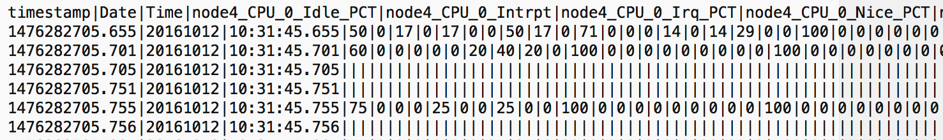
Parsing and Data Integration Approach - Collectl Example
Parser design – relational model foundation
Normalized time (epoch, GMT)
Attribute label uniqueness, consistency
Symbols converted to English, i.e. % => PCT
Numbering added to Resource Category, i.e. CPU_0, CPU_1, etc, to ensure uniqueness
Column name grammar aids data integration
Hostname_ResourceCategory_Attribute_Metadata
Makes explicit the node-to-resource relationship
Sample Collectl Output

Slide 27
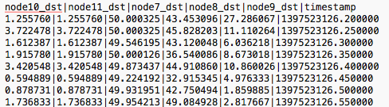
Processing Resource Monitor Data
dst_multifile_parser.py processes component logs, calculates downstream service time and integrates values across time
collectl_multifile_parser.py processes collectl data and integrates values across time

Slide 28
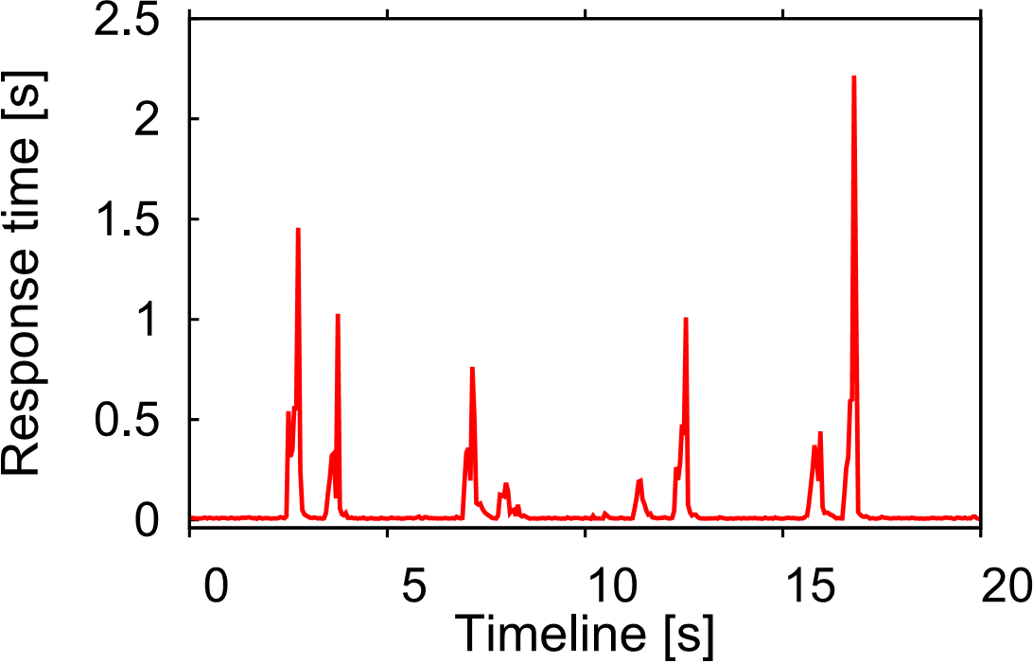
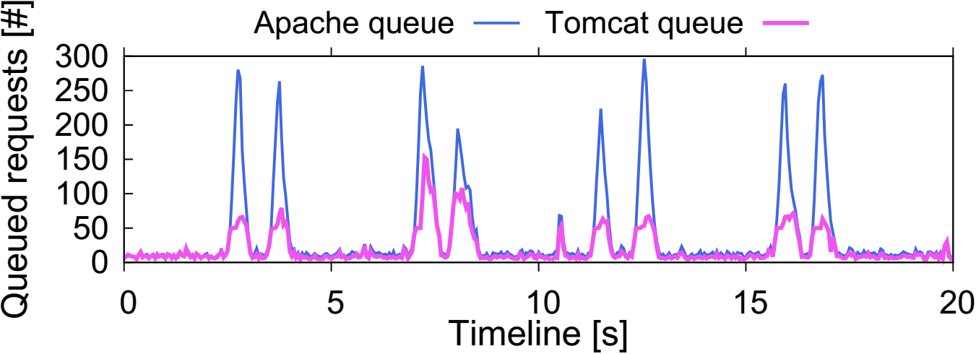
Example Diagnostic Graphs
Point-in-Time Response Time Graph
Queue Length Graph

Slide 29
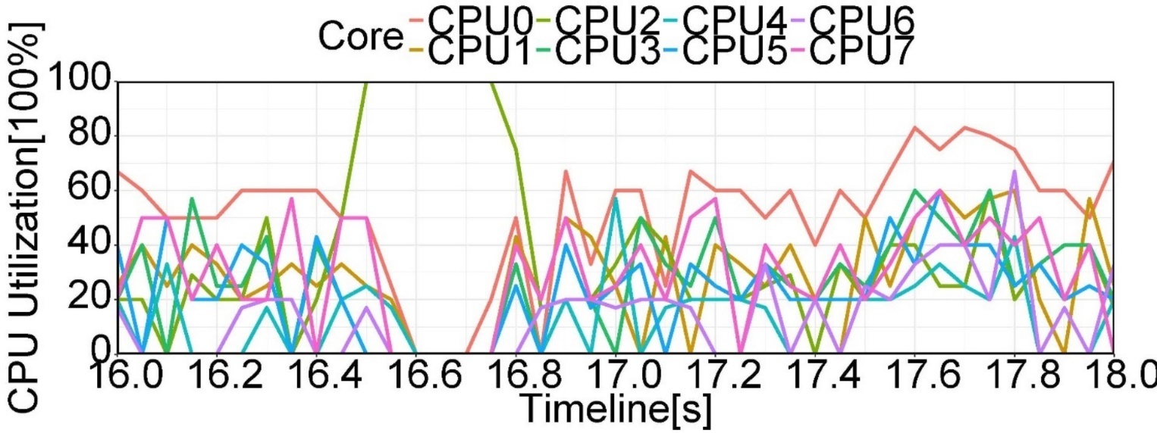
Example Diagnostic Graphs
Resource (CPU) Utilization Graph
Downstream Service Time Graph. Similar to PiT graph but generated for each node.

Slide 30
MilliAnalyst
Uniform data interface consisting of three entities:
PointinTime
DownstreamServiceTime (DST)
ResourceObservations
Each of these entities can have a variable number of number of attributes
Experiment specification impacts this, i.e. the number of nodes determines the number of DST attributes
Number of attributes can also depend on characteristics that might not be known prior to running an experiment, such as a node’s number of CPUs, cores, NICs or disks

Slide 31
Method needs to handle this variable number of attributes, i.e. no fixed schemas
Method needs to be able to integrate data across time and space
Representation needs to be able to handle data anomalies and support efficient filtering and retrieval of small data subsets across all of the measurements
Support graph-based reasoning

Slide 32
Millibottleneck Summary
Millibottlenecks happen in different system layers
System software: Java garbage collection
Processor architecture: DVFS
Application Virtual Machine consolidation
Though short-lived, millibottlenecks have big impact on n-tier application performance
VLRT requests
Queue amplification from n-tier system component dependencies
Notes:
So far I have introduced three causes of transient bottlenecks in different system layers,
Java GC in the system software layer,
DVFS in the Processor architecture layer,
And VM consolidation in the application layer
In all these three cases, I showed that even though transient bottlenecks are short-lived, they have big impact on system performance. For example, they cause large response time fluctuations for web applications. This is because of the push-back wave caused by complex resource dependency in the system.

Slide 33
Discussion on Solutions
Three kinds of solutions for Latency Long Tail Problem
Bug-fix, specific solutions for each cause (many causes, not all can be fixed)
General solutions for transient bottlenecks (primarily improved queue management)
Last-resort solution

Slide 34
Bug-Fix, Specific Solutions
Some cases can be “fixed”
Java GC in JVM 1.5 was “fixed” in JVM 1.6
DVFS anti-synchrony can be “fixed” by changing control periods (some complications)
Other cases are harder to fix
VM consolidation case (noisy neighbor) is really non-deterministic
Kernel daemon processes (many)

Slide 35
More General Solutions
Approaches that address transient bottlenecks (instead of specific “bugs”)
3 stages: (1) transient bottleneck formation, (2) queue amplification, (3) packet retransmission
(1) Transient bottleneck detection and remedial action (e.g., disruption)
Difficult, due to the short lifespan of transient bottlenecks

Slide 36
(2) Disrupting Queue Amplification
Deeper queues
They only postpone queue overflow, but they create queue bloat problem (very bad)
Differentiated classes of services
Let short tasks “get around” long tasks
Current research topic
(3) Packet retransmission
Requires prevention, same as (2)
New Linux TCP timeout (1 sec instead of 3sec)

Slide 37
Last-Resort Solution
Zero knowledge on causes; just maintain very low utilization on all resources (CPU)
A “safe” utilization cap depend on many factors, including burstiness of workload
Turns out to be the most popular solution
Gartner reports on average data center server utilization: 18%; other reports as low as 6%
Google reports 30% (including batch jobs)
Obviously not an ideal situation for ROI

Slide 38
Research Challenges in Clouds
ROI can be improved (a lot)
A challenging problem: latency long tail
Very long response time (VLRT) requests
Difficult to reproduce, almost invisible
We found 3, but there are many more
Cause-specific bug fixes are limited to each case
Transient bottlenecks as a simple model for more generic solutions

Slide 39
Dependency Management and Cloud Experimentation
Many dependencies are unknown a priori
Deploying and executing experiments would fail, i.e. unmet dependency
Building new toolchain to account for dependencies more explicitly

Slide 40
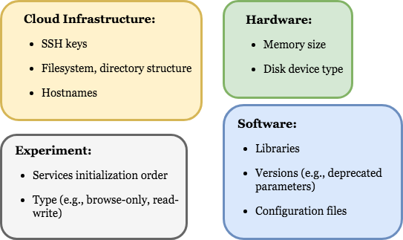
WED-Make
A build automation tool
Declarative syntax
Explicit dependencies for the execution of each task
Dependencies collectively determine the execution order of tasks

Slide 41
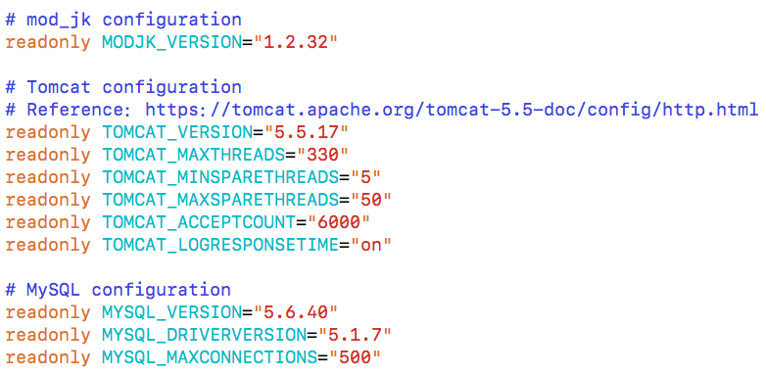
Experiment Configuration
The initial execution state is defined in a plain Bash script file
Initial valuation of variables, i.e., configuration parameters

Slide 42
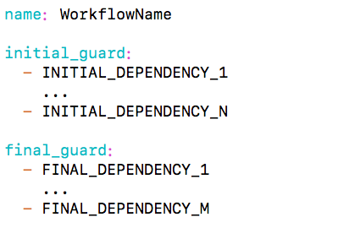
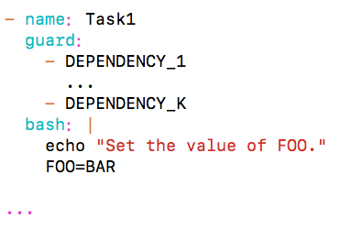
WED-Makefile
Event-based, data-driven workflow specification
Composed by a name, an initial guard (start condition), a final guard (stop condition), and a collection of tasks
Task: name + guard (list of dependencies to be satisfied) + bash (script to be run when guard is satisfied)

Slide 43
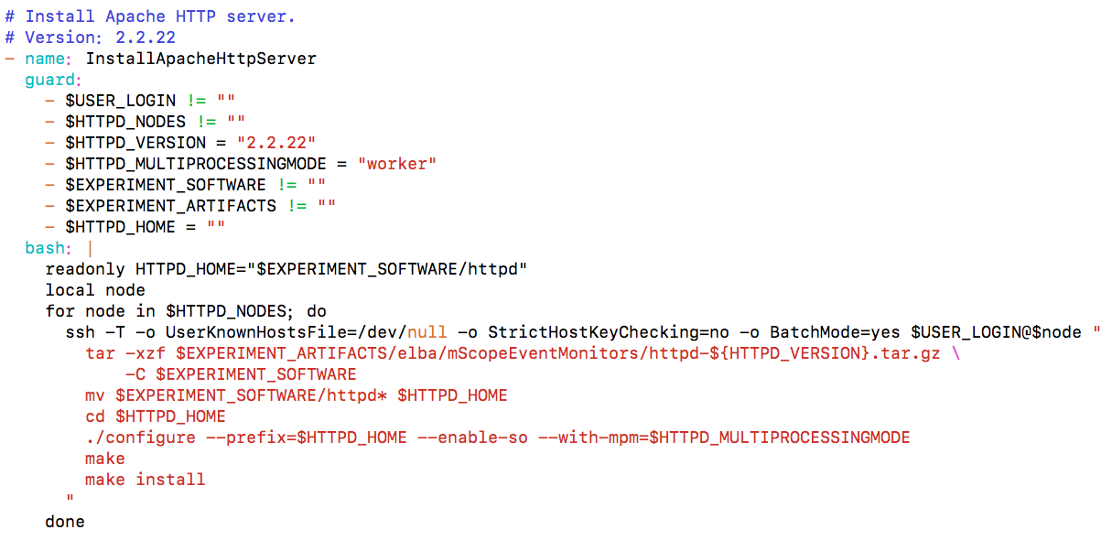
Example: Installation of the Apache HTTP server

Slide 44
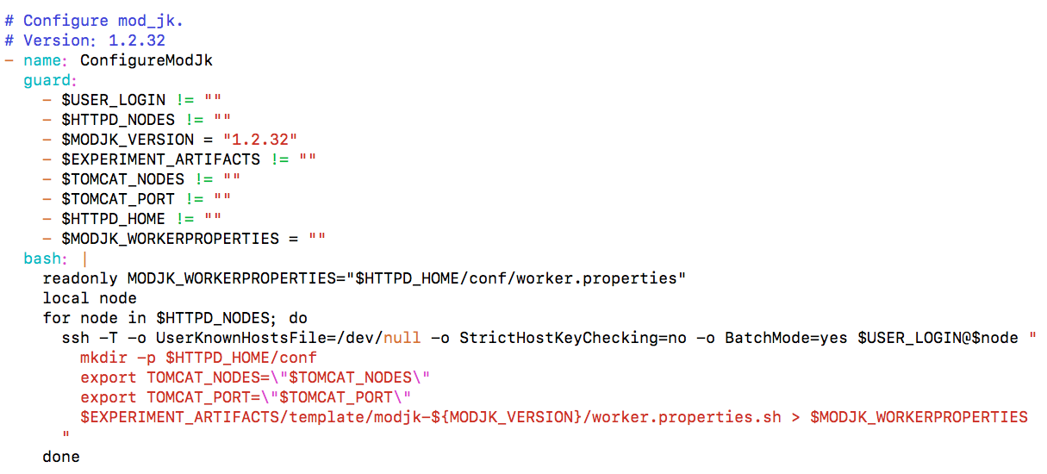
Example: Configuration of mod_jk

Slide 45
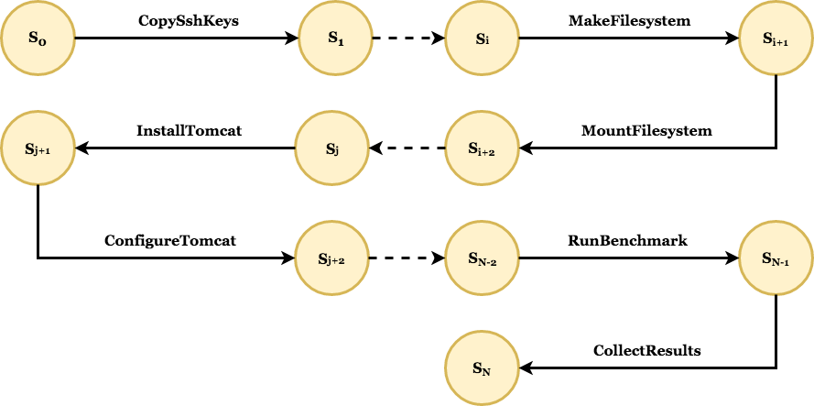
Control-flow
Whenever the global execution state (i.e., the values of global variables) is updated, guards of all tasks are evaluated
If a guard is satisfied, the execution of its associated Bash script is triggered
The execution of a Bash script updates the global execution state
The loop continues until the final guard (stop condition) is satisfied

Slide 46
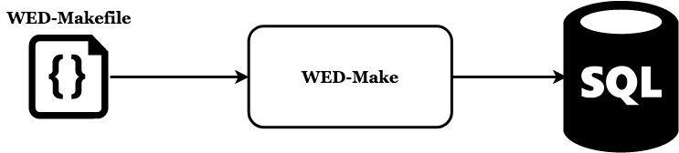
Runtime System
WED-Make parses a WED-Makefile and generates SQL code to be installed on a database server
SQL triggers and stored procedures manage the execution of WED-Makefile instances
Transactional execution: ACID transactions wrap the execution of tasks

